Slide 1

TOPICS TO BE COVERED
Low level of Economic Development under the Colonial Rule.
Agricultural Sector
Industrial Sector
Foreign Trade
Demographic Condition
Occupational Structure
Infrastructure

Slide 2

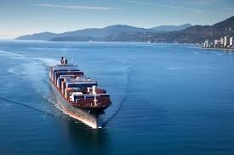
INTRODUCTION
The primary objective of British Colonial rule in India was to turn India
As a supplier of raw material and
As a consumer of finished goods

Slide 3
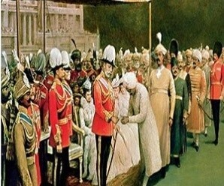
COLONIALISM
Colonialism refers to a system of political and social relation between two countries, of which one is the ruler and the other is its colony.
The ruling country not only has political control over the colony, but it also determines the economic policies of the dominated country.
In case of India, the unequal relationship between the colony[India] and the ruling country [Britain] resulted in underdevelopment of India.

Slide 4
LOW LEVEL OF ECONOMIC DEVELOPMENT
BEFORE BRITISH RULE
India was well known for its handicrafts industries in the fields of cotton and silk textile, metal and precious stone works etc. These products enjoyed a world wide market based on the reputation of fine quality of material used and the high standards of craftsmanship seen in all imports from India.

Slide 5
LOW LEVEL OF ECONOMIC DEVELOPMENT
DURING BRITISH RULE
The economic policies pursued by the colonial government in India were concerned more with the protection and promotion of the economic interest of their home country than with the development of the Indian economy. Such policies brought about a fundamental change in the structure of the Indian economy
  Transforming the country into a net supplier of raw materials and
  Consumer of finished industrial products from Britain.
The country's growth rate during the first half of the twentieth century was less than 2% and growth rate of per capita output was only 0.5%.

Slide 6
ESTIMATION OF NATIONAL INCOME DURING C.G.
The C.G. never made sincere attempt to estimate India’s National Income and Per Capita Income.
There were some individual attempts which were made to measure.They are as follows:
Dada Bhai Naoroji
William Digby
Findlay Shirras
V.K.R.V. Rao and
R. C. Desai

Slide 7
AGRICULTURE SECTOR
India’s economy under the British colonial rule remained fundamentally agrarian. About 85% of the country’s population lived in villages and lived on agriculture. However, the agricultural sector continued to experience stagnation and deterioration.

Slide 8
REASONS FOR STAGNATION
Land settlement system: In the zamindari system, which was introduced by the colonial government, the profits occurring out of the agricultural sector went to the zamindars instead of the cultivators. The main interest of the zamindars was only to collect rent regardless of the economic condition of the cultivator.
❑ Commercialisation of Agriculture
Low level of technology due to lack of knowledge, means and incentives for modernization.
Lack of irrigation facilities.
Negligible use of fertilizers.

Slide 9
COMMERCIALISATION OF AGRICULTURE
The British industrialists were always in the need of raw materials like cotton, indigo, jute, groundnut, sugarcane, etc. to keep their factories running;
By offering higher prices, the Indian peasants were attracted to production of commercial crops instead of food crops;
The extent of commercial agriculture went so far as to make many peasants purchase their food requirements from shops in towns;
This fall in production of food crops was responsible for frequent famines in India during the British days.
Growing of cash crops instead of food crops is called Commercialisation of Agriculture.

Slide 10
INDUSTRIAL SECTOR
➢India could not develop a sound industrial base under the Colonial Rule.
➢Even the country’s world famous handicraft industries declined.
➢No commercial modern industrial base was allowed to come up.
➢This sector needed modernisation, diversification and increased investment.

Slide 11
The primary motive behind this policy of deindustrialization was:
To reduce India to the status of mere exporter of important raw materials for the upcoming modem industries in Britain.
To turn India into a market for the finished products manufactured by industries in Britain.
The rate of growth of the industrial sector was low as no help was being provided to these industries by the colonial government.
Colonial Government enforced discriminatory tariff policy, which allowed free export of raw materials from India and free import of final goods from British industry to India.
The decline of the traditional handicraft industries created massive unemployment in India.
The fall in supply of locally made goods created a demand for the import of British goods much to their advantage.

Slide 12

FOREIGN TRADE
India has been an important trading nation since ancient time. But the restrictive policies pursued by the Colonial Government adversely affected the structure, composition and volume of India’s foreign trade.

Slide 13
Composition of India's Trade India became an exporter of primary products such as raw silk, cotton, wool, sugar, indigo, jute, etc and an importer of finished consumer goods like cotton, silk and woollen clothes and capital goods like light machinery.
Volume India's exports were more than its imports so there was a large export surplus Direction. This refers to the countries we are trading with Britain maintained a monopoly over India's exports and imports
More than half of India's foreign trade was restricted to Britain while the rest was allowed with a few countries like China, Ceylon (Sri Lanka) and Persia (Iran)
Suez Canal was opened in 1869
It reduced the cost and time of transportation and made access to the Indian market easier.
In other words, exploitation of Indian market was now easier.
•

Slide 14
India’s foreign trade generated huge export surplus but this surplus came at a huge cost to the country’s economy as it led to the drain of India wealth.
The export surplus was used for:
Making payments for the expenses incurred by an office set up by the colonial government in Britain.
Expenses on war fought by the British government
Import of invisible items

Slide 15
The demographic conditions during the British rule suggested all the features of a backward economy. Various details about the population was first collected through a census in 1881.Before, 1921, India was in first stage of demographic transition. The second stage of transition started after 1921. However, neither the total population of India nor the rate of Population growth at this stage was very high. The year 1921 is described as the “Year of Great Divide”. It is because after 1921 population grew continuously and rapidly.

Slide 16
The demographic conditions were as under:-
The overall literacy level was less than 16%.
Female literacy was 7%.
Overall mortality rate was high
Infant mortality rate was 218 per thousand (Present rate is 44/1000)
Life expectancy was also very low-32 years (Present 68 years)
Extensive poverty was present
Public health facilities were either unavailable to large chunks of population or were highly inadequate when available.
Water and air borne diseases were rampant.

Slide 17
OCCUPATIONAL STRUCTURE
OCCUPATIONAL STRUCTURE
PRIMARY SECONDARY TERTIARY

Slide 18
By occupational structure we mean the distribution of working persons across different industries and sectors. During the colonial period the occupational structure of India showed little sign of change.
The largest share of work force, i.e. 70-75% was in the agricultural sector.
The manufacturing sector accounted for 10% and the services sector 15-20% respectively.
Regional disparities were also an important feature
There was a decline in the dependence of the work force on the Agricultural sector in parts of the then Madras Presidency (i.e. Present-day Tamil Nadu, Andhra Pradesh, Kerala and Karnataka), Maharashtra and West Bengal and increase in the manufacturing and the services sector
There was an increase in the share of the work force in agriculture in the states such as Orissa, Rajasthan and Punjab

Slide 19
Under the Colonial rule, basic infrastructure such as Roads, Railways, Ports, Water Transport, Post and Telegraph etc. were developed. But this development was not to provide basic amenities to the people of the country, but to subserve the colonial interests.
The roads were built for mobilizing the army within India and for drawing out raw, materials from the countryside to the nearest railway station or the port to send these to England or other foreign lands.
The Railways helped in commercialization of Indian agriculture which adversely affected the comparative self-sufficiency of the village economies in India.
The introduction of the expensive system of electric telegraph in India, similarly served the purpose of maintaining law and order.

Slide 20
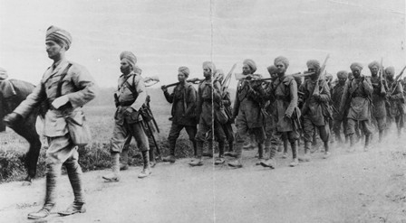
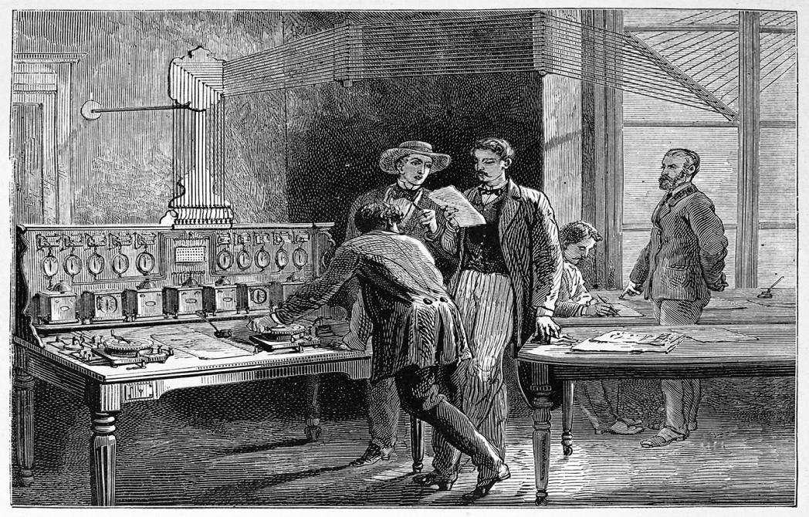
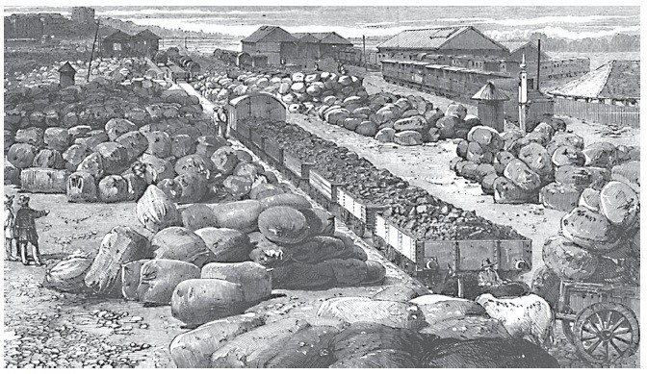
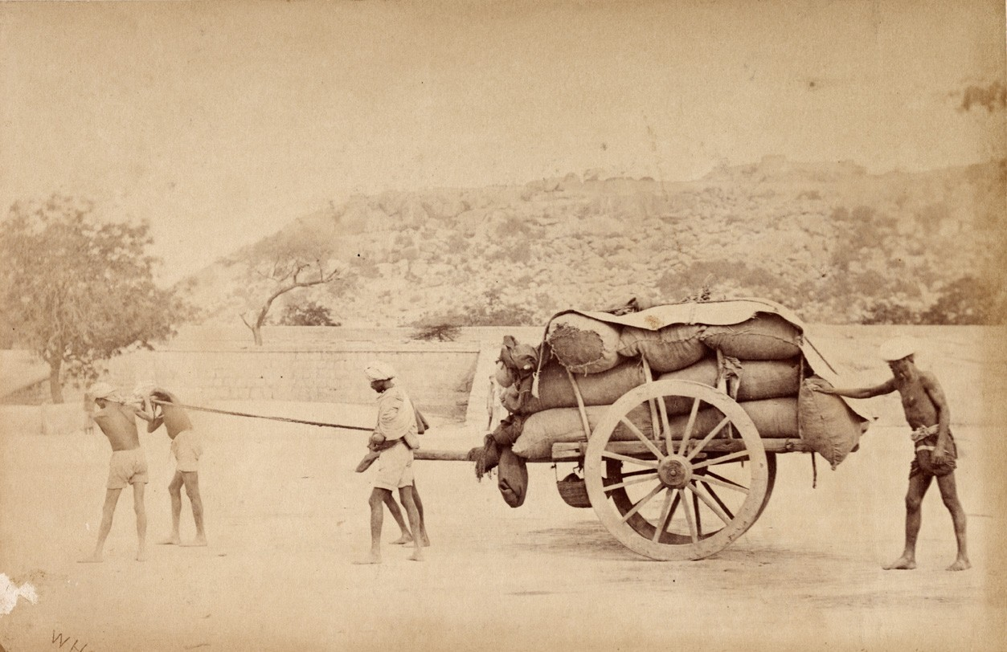

Slide 21
EFFECTS OF RAILWAYS
The British introduced the railways in India in 1850. It is considered one of the most important contributions. It affected the structure of the Indian railways in many ways,
It enabled people to undertake long distance travel and thereby break geographical and cultural barriers.
It helped in integrating the nation.
It fostered commercialisation of Indian agriculture which adversely affected the self-sufficiency of the village economies in India.
The volume of India's export trade undoubtedly expanded.
It provided employment opportunities to the people.

Slide 22
POSITIVE CONTRIBUTION
NEGATIVE IMPACT DURING INDEPENDENCE/CHALLENGES
They introduced the railway system
They developed the modern system of communication.
The modern banking system was established by Britishers They formed the Imperial Bank of India Till the establishment of Reserve Bank of India (1935), the Imperial Bank served as the government's banker and also managed its public debt
They developed irrigation works, which created new grain and cotton producing regions
Political and unification of country
Per capita income was low.
Large scale unemployment and under- employment.
The industrial sector was crying for modernization, diversification,
capacity building and
public capital
investment. There was no goods industry.
The agricultural sector was saddled with surplus labour and extremely low productivity.
Mass illiteracy

Slide 23
CONCLUSION
After finishing the chapter students will come to know that the social and economic challenges before the country were enormous

